Slide 1

DEPARTMENT OF INFORMATION TECHNOLOGY
RMD SINHGAD SCHOOL OF ENGINEERING
WARJE, PUNE-411058
This is to certify that the Project Base Learning Report entitled
“Data Base Management System ”
Submitted by
Name: Roll No./Exam Seat No. :
Samrudhi Manchekar S191028543
is a Bonafide work carried out by him/her under the supervision of Prof. Shivai Aher and it is submitted towards the partial fulfillment of the requirement for S.E (Information Technology) – 2019 course of Savitribai Phule Pune University, Pune in the academic year 2020-2021.
(Prof.Shivai Aher) (Prof. Sweta Kale) (Dr. V.V. Dixit)
Project Guide Head Principal,
Department of Information Technology Department of Information Technology RMD Sinhgad School of Engineering Pune – 58
Place: Pune Date:

Slide 2


Blood Bank Database Management System .

Slide 3

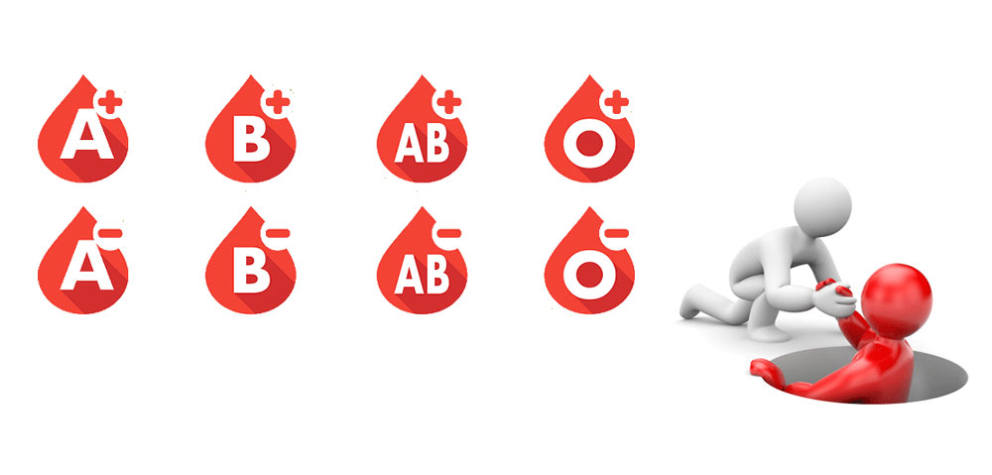


Blood banking is the process that takes place in the lab to make sure that donated blood or blood products, are safe before they are used in blood transfusions and other medical procedures.
Blood Donation Is The Act Of Giving Blood To Someone Who Needs It. It Is Not Just About Giving Blood, But It Is An Act Of Kindness That Saves .

Slide 4
Introduction
Technology is introducing new innovations day by day, thus reducing the time required to do things. The proposed system can be used to reduce the time required to deliver required blood to the needy in cases of emergency. It provides a way of communication and synchronization between the hospitals and the blood banks. It also provides them with the facility of communicating with the nearby donors in emergencies. The purpose of this study was to develop a blood management information system to assist in the management of blood donor records, seeker records, blood stock details and easy to control . The database is the single most useful setting for caching data, and it is also an ideal tool for contriving, managing, updating, and modifying data from different angles. The benefits of a well-structured blood bank database are limitless and yield the benefits of improving efficiency and saving time.

Slide 5
Motivation
When it comes to the efficiency and high productivity of Blood Bank Management, we require a well-built management system which makes all work easy. Blood Bank Mangement System not only increase efficiency but also reduces the workload of employees by which it speeds ups the management system. This System is useful while held a Blood Donation Camp.

Slide 6
Objectives
To overcome the drawbacks of the previously existing Blood Donation Management system. This is a web application allows you to access the whole information about Blood Bank Management Software, readily scalable and adaptable to meet the complex need of Blood Banks Who are Key Facilitator for the Healthcare Sector, it also supports all the functionalities of Blood Bank.

Slide 7
Problem Statement
Lack of immediate retrievals , Lack of immediate information storage ,Lack of prompt updating , Error prone manual calculation all these problems overcome by Blood Donation Management System in short to overcome the drawbacks of the previously existing Blood Donation Management system. Goals of proposed system is to be an immediate retrieval of information , no redundancy, accuracy , immediate storage of information respectively .

Slide 8
Project Requirement Specification (SRS)
Once the analyst has performed all the above mentioned activities, all the requirements are to be systematically organized in the form of an SRS document. The SRS document usually contains all the user requirements in an informal form.
An SRS document clearly documents the following aspects of a system:
Environmental characteristics
Hardware
Software
Functional Requirements
Non-Functional Requirements

Slide 9
Environmental Characteristics:
Server Side
Hardware Requirements
Processor | 2.4GHz |  | 40GB Free Space
Ram | 4 GB
Software Requirements
Operating System |  | Windows server 2003
Back-End Tools |  | MYSQL Server 5.1

Slide 10
Client Side
Hardware Requirements
Processor | 1.9GHz |  | 20 GB Free Space
Ram | 1 GB
Software Requirements
Operating System |  | Windows s XP or Any compatible OS
Web Browser |  | Internet Explorer 5.0 or Any compatible Browser
Functional requirement :
Each high-level functional requirement corresponds to an instance of use of the system by the user in some way. Each high-level requirement typically involves accepting some data from the user, transforming it to required response, and outputting the response to the user.

Slide 11
Some of the functional requirements which we have tried to gather for our Life Saviour Blood Bank Management System are as:
Donor Table
Employee Table
Blood Stock Table
Seeker Table
Hospital Table
Non-Functional Requirements:
Non-Functional requirements are the ones that specify criteria that can be used to judge the operation of a system, rather than specific behaviour.
The ones concerned for the project are as:
Performance
Good performance is maintained by providing a reliable and high quality service to the donors as customer satisfaction is the top most priority.
Testability
Testability refers the capability of a system to be tested. As this system depicts a real life scenario it can be easily tested, as to how it is able to store donor detail

Slide 12
Non Functional Requirements
Accessibility
Accessibility can viewed as the ‘ability to access’ and benefit from some system or entity. System is accessible only to admin in this case and hence is easily accessible and easy to maintain.
Robustness
Robustness is the ability of a system to cope with errors during execution. As the system has been tested for all sorts of invalid and unexpected inputs hence it is Robust in nature.
Security
Security is the degree of protection against danger, damage, loss and crime. In order to ensure security, a login is maintained which is user name and password secured and hence forth is accessible by only certain trustworthy people from admin.

Slide 13
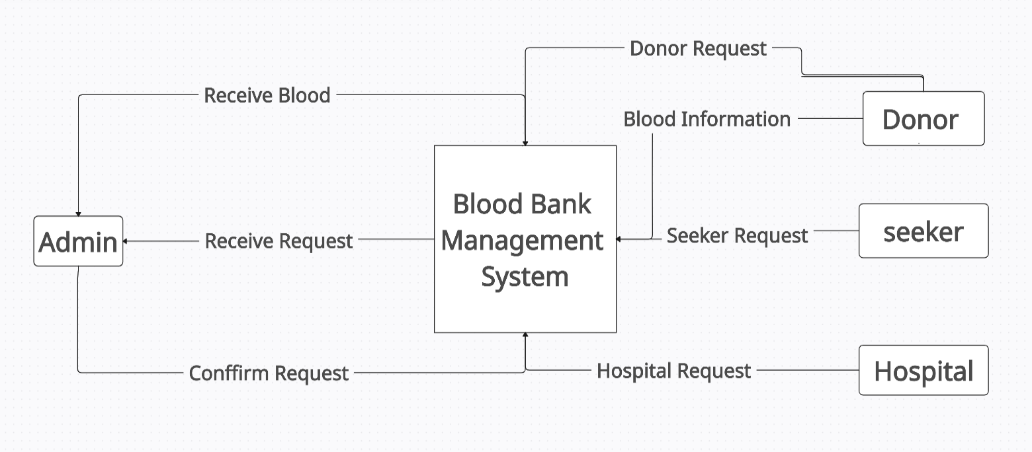
Hight Level Design of the Project
Data Flow Diagram

Slide 14
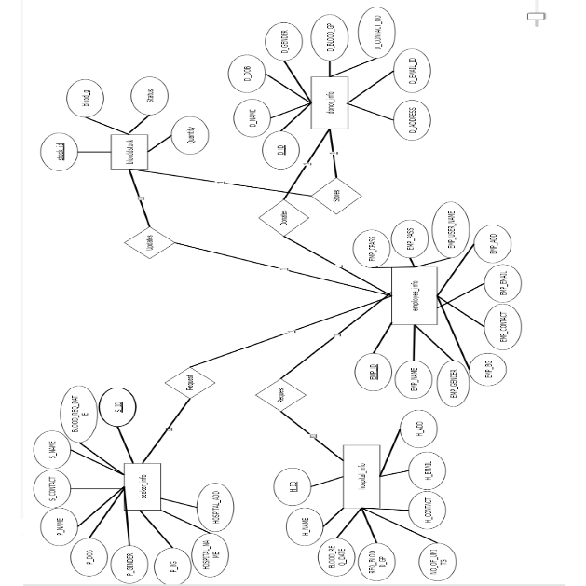
E-R Diagram
E-R Diagram of Blood Bank Management System

Slide 15
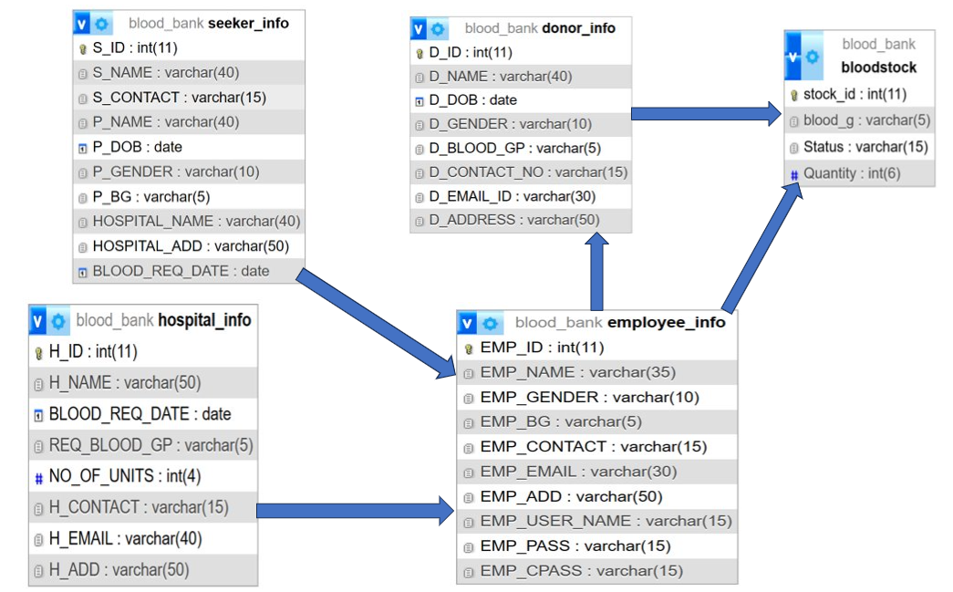
UML Diagram

Slide 16
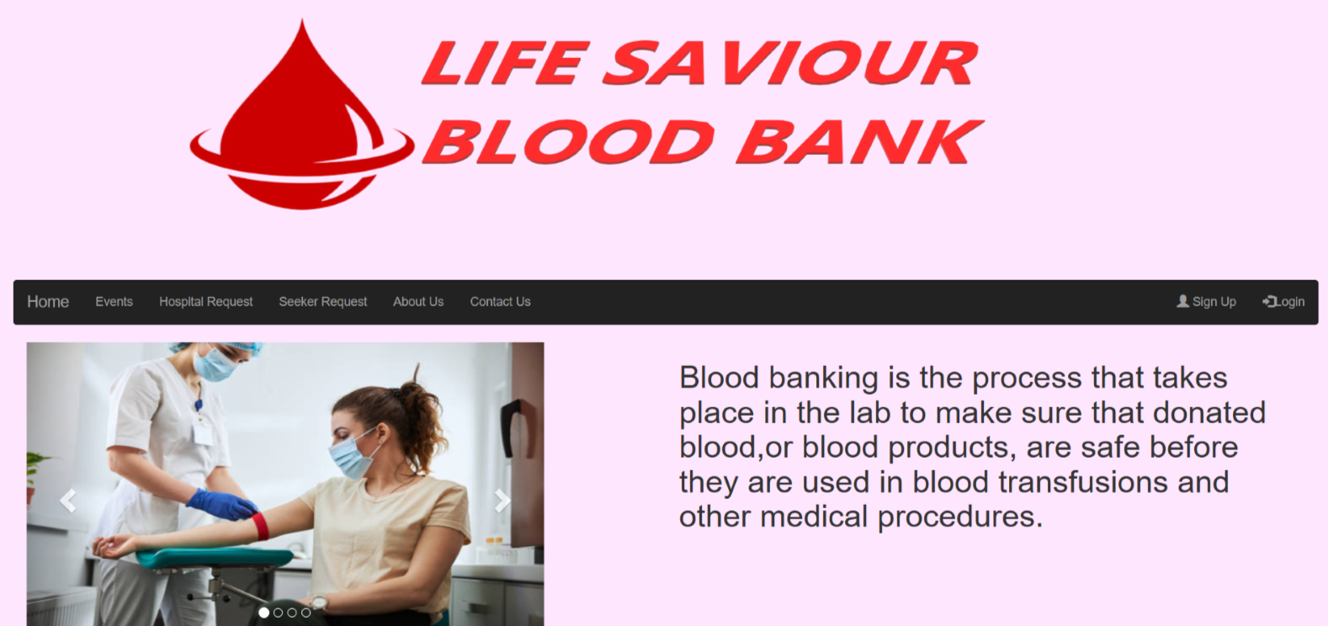
Front End Part
Fig 1: Home Page of Blood Bank

Slide 17
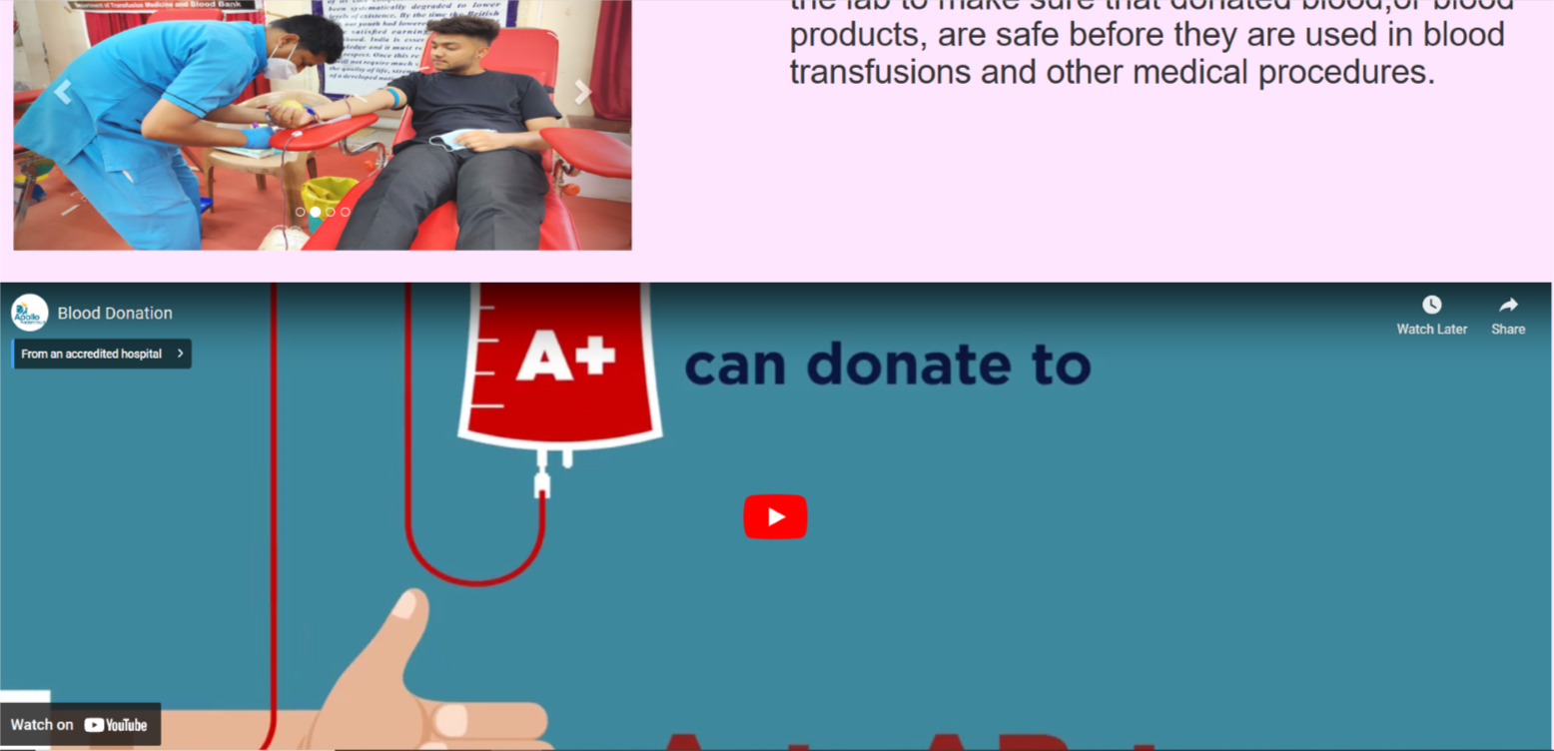

Slide 18
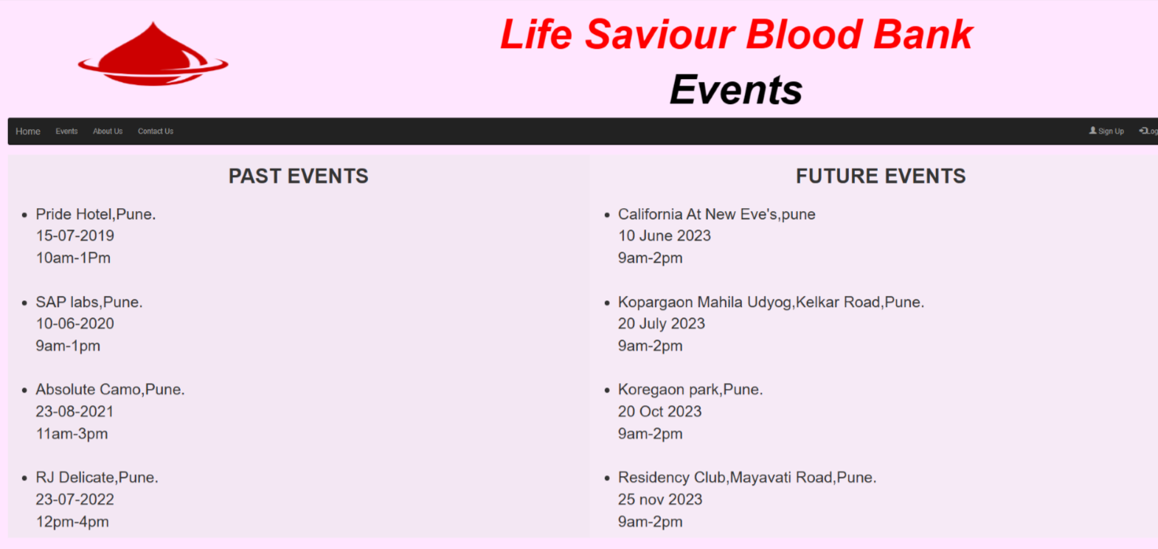
Fig 2: Event Page

Slide 19
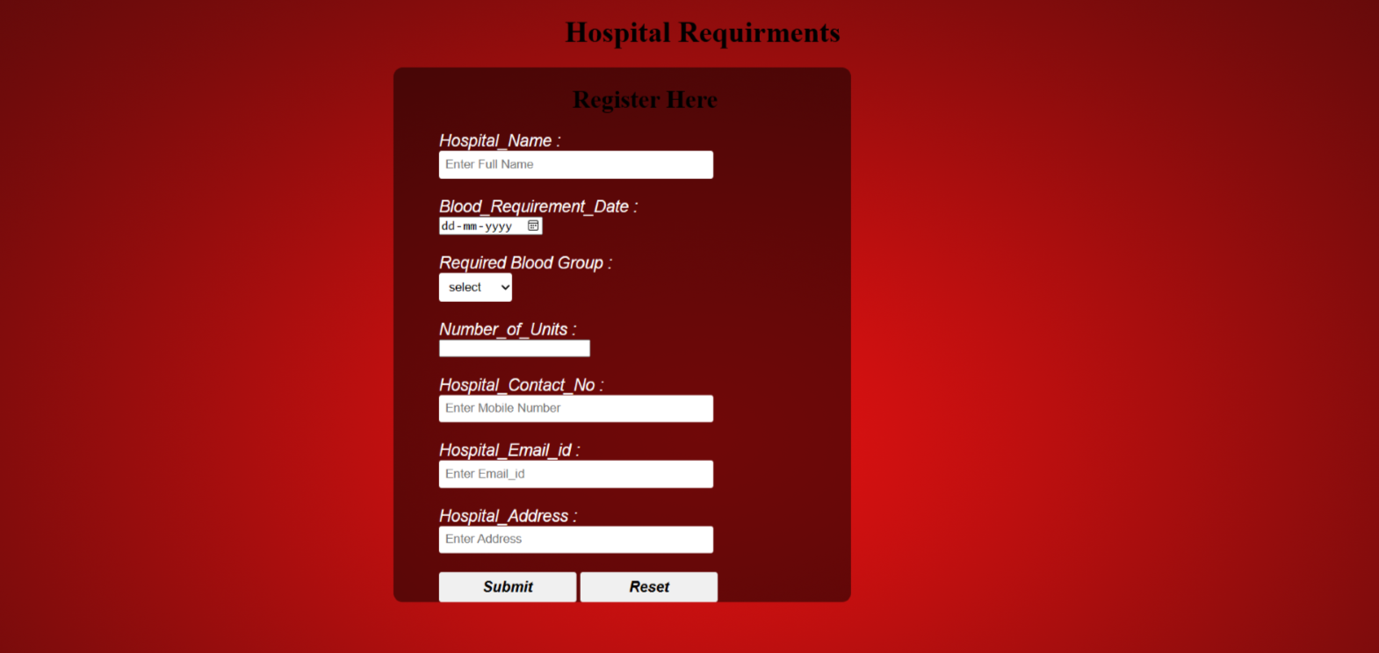
Fig 3: Hospital Registration Form Page / Dashboard Page

Slide 20
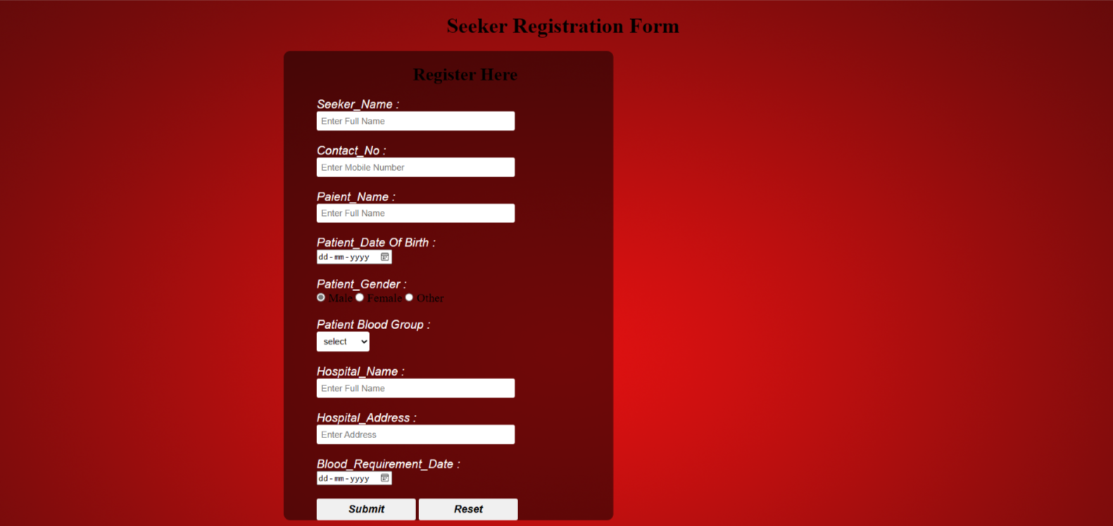
Fig 4: Seeker Registration Form Page / Dashboard Page

Slide 21
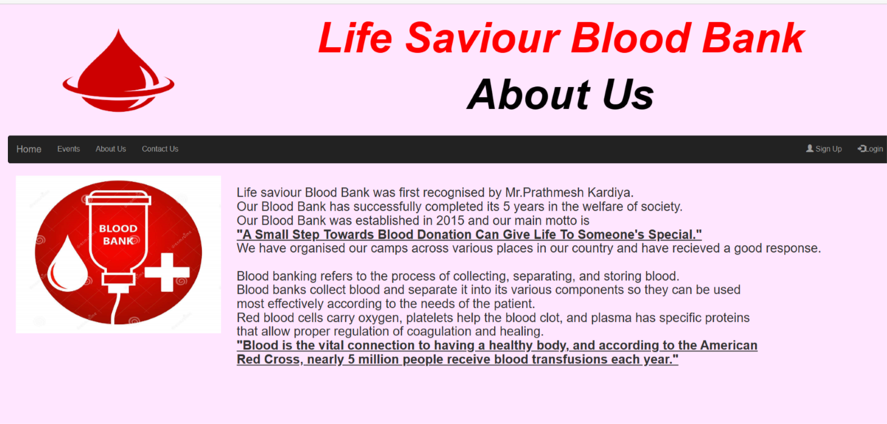
Fig 5: About us Page

Slide 22
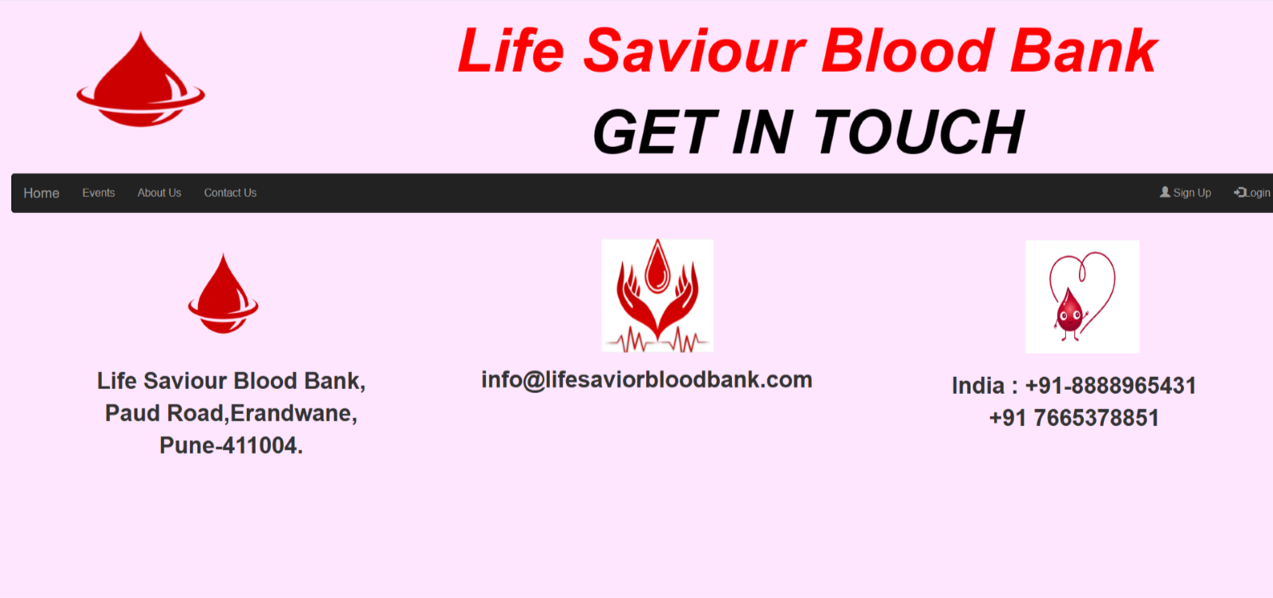
Fig 6: Contact Us Page

Slide 23
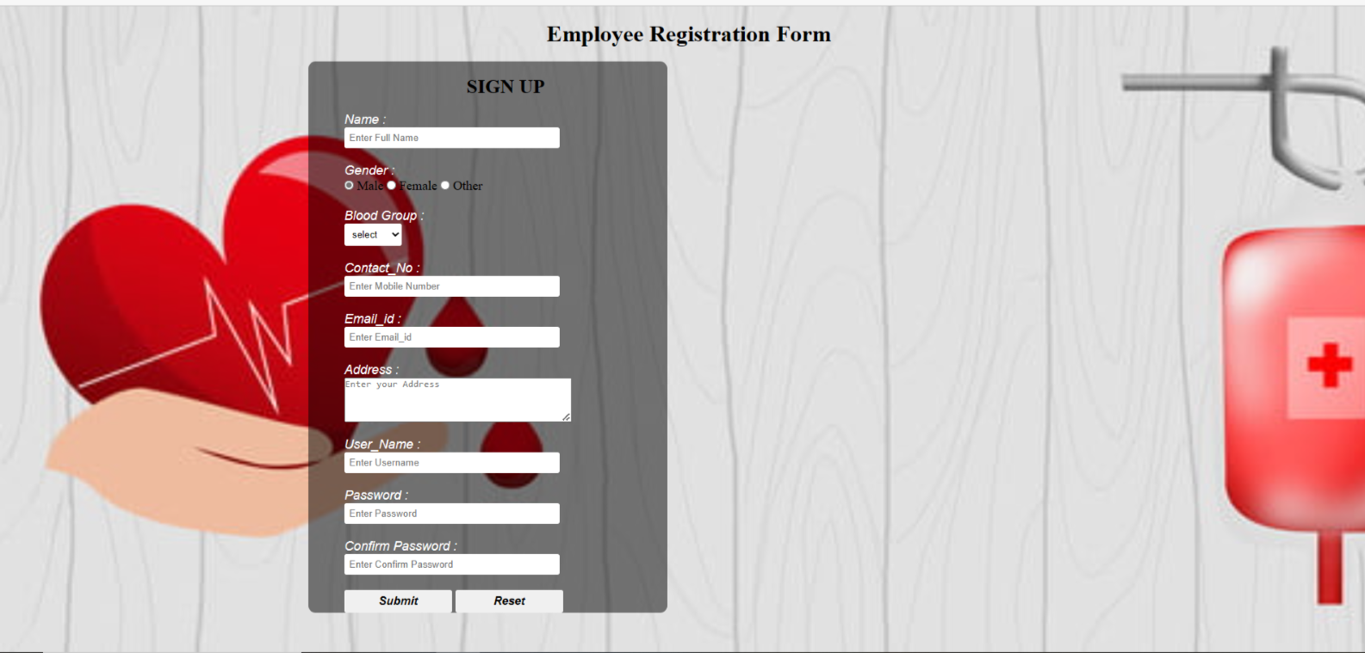
Fig 7: Sign Up Page

Slide 24
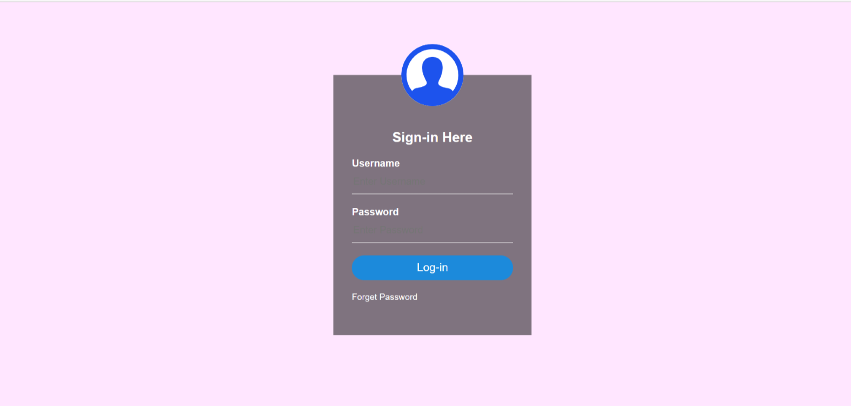
Fig 8: Login Page

Slide 25
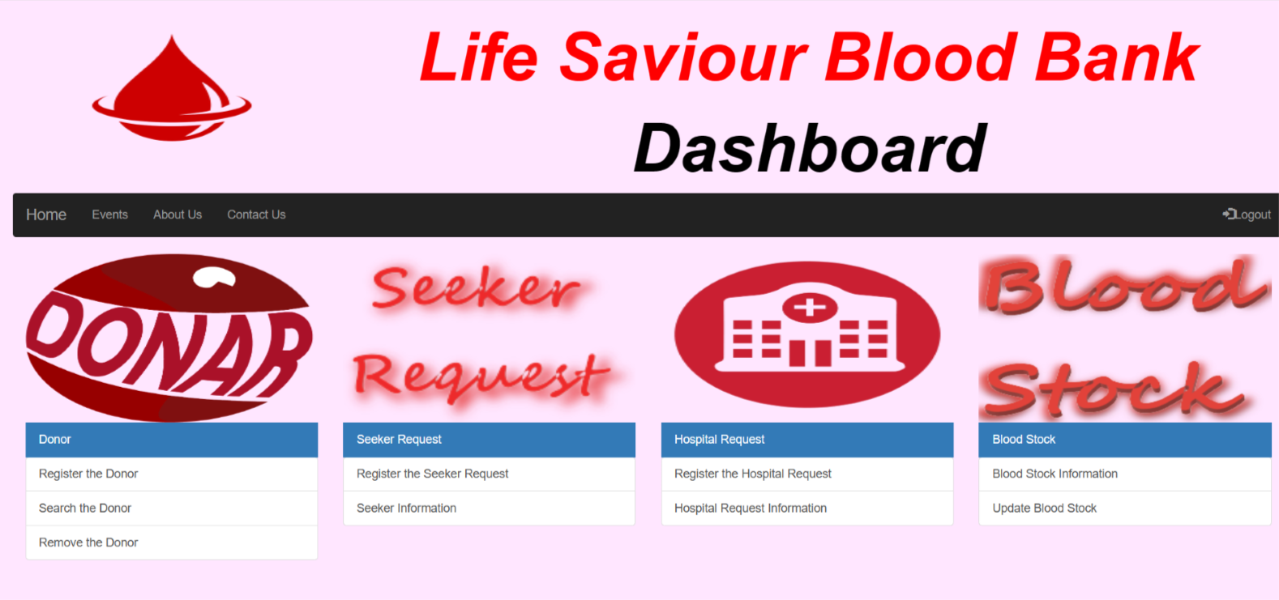
Fig 9: Dashboard Page

Slide 26
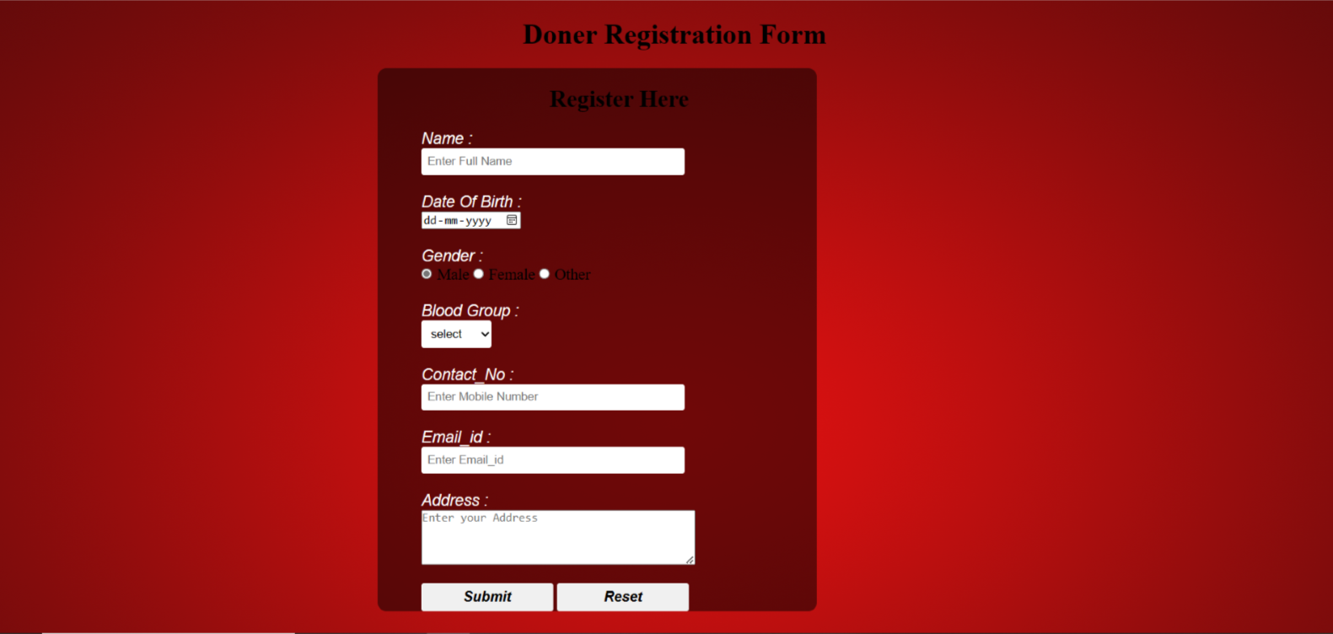
Fig 10: Donor Registration Page

Slide 27
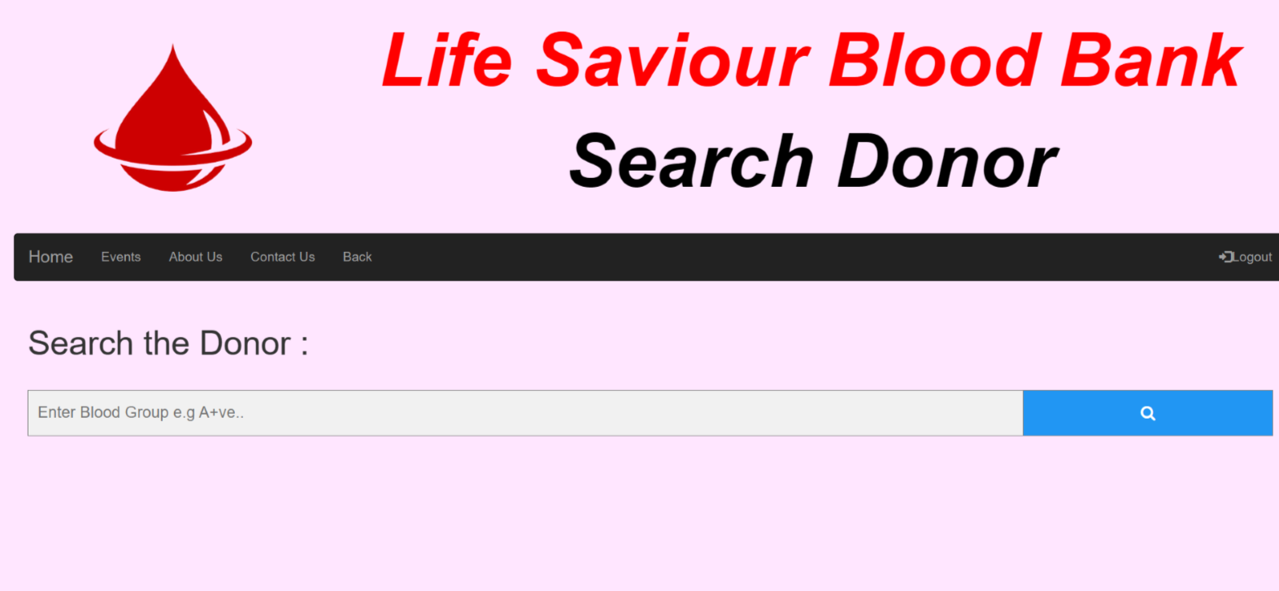
Fig 11: Donar Search Page

Slide 28
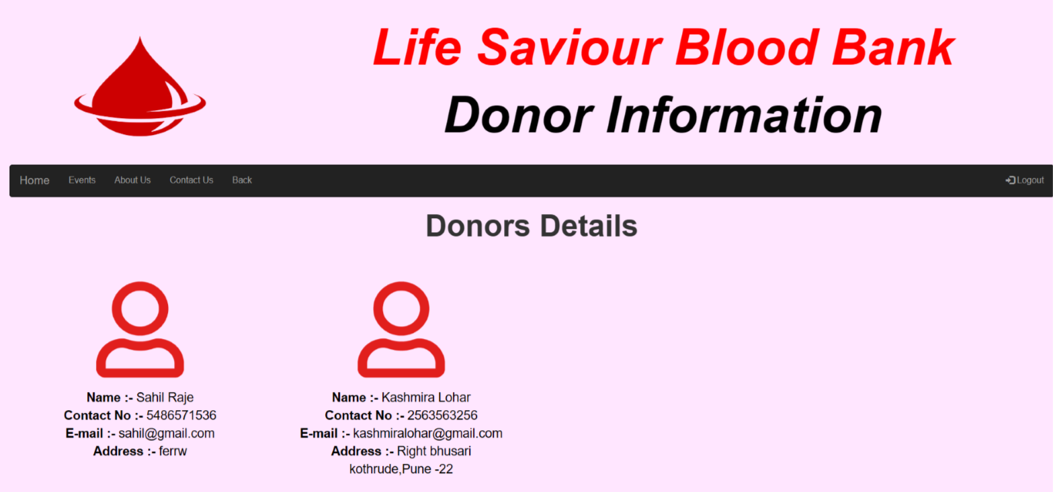
Fig 12: Result After Searching Donor Page

Slide 29
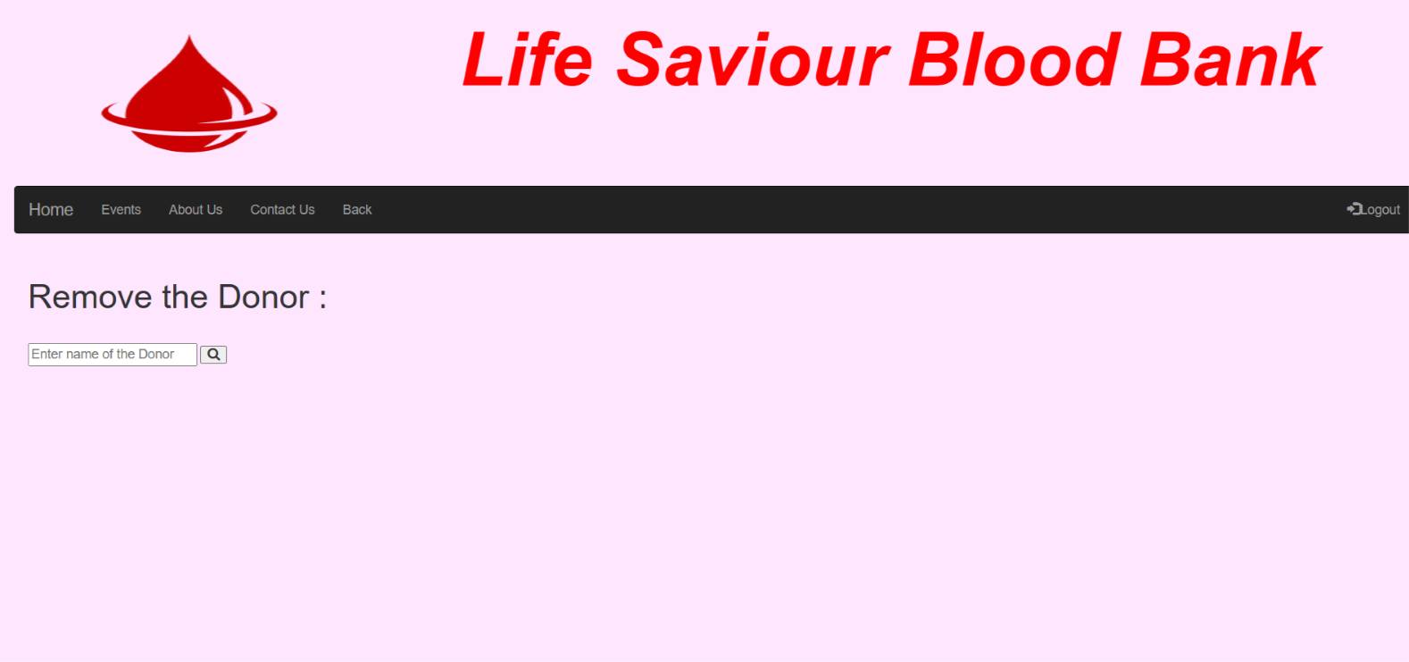
Fig 13: Remove Donor Page

Slide 30
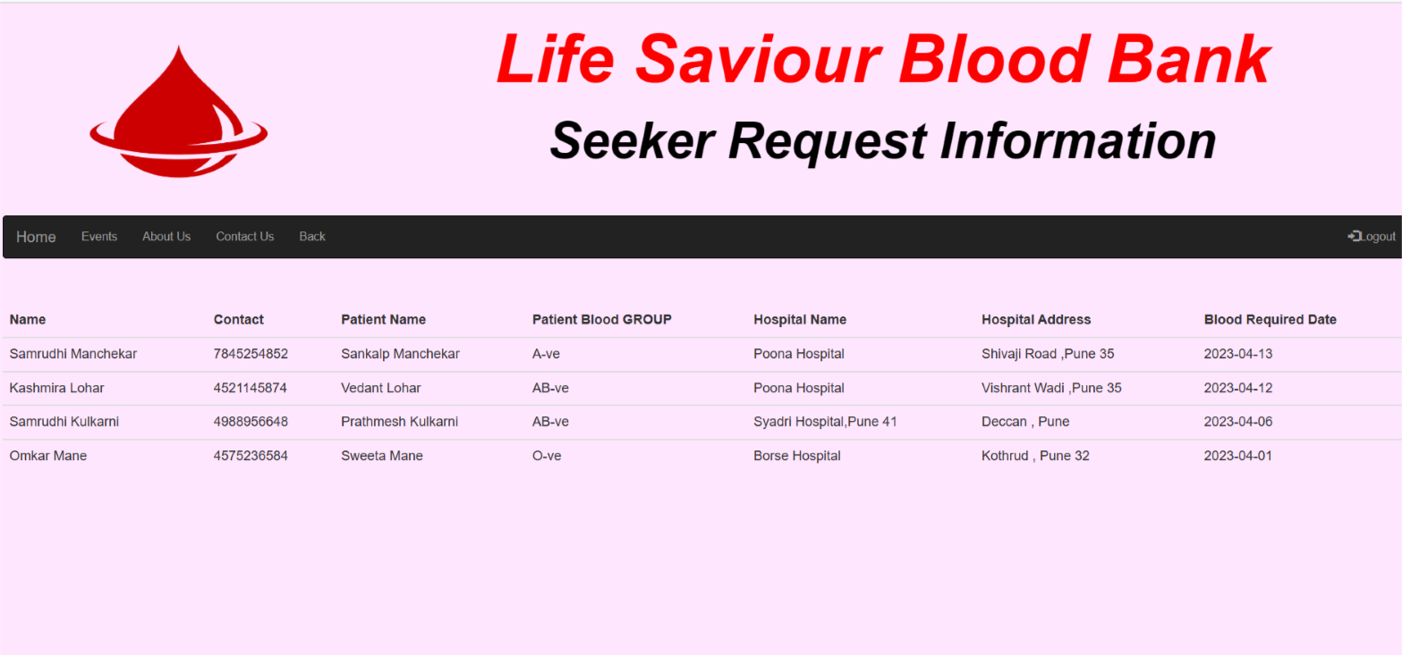
Fig 14: Seeker Information Page

Slide 31
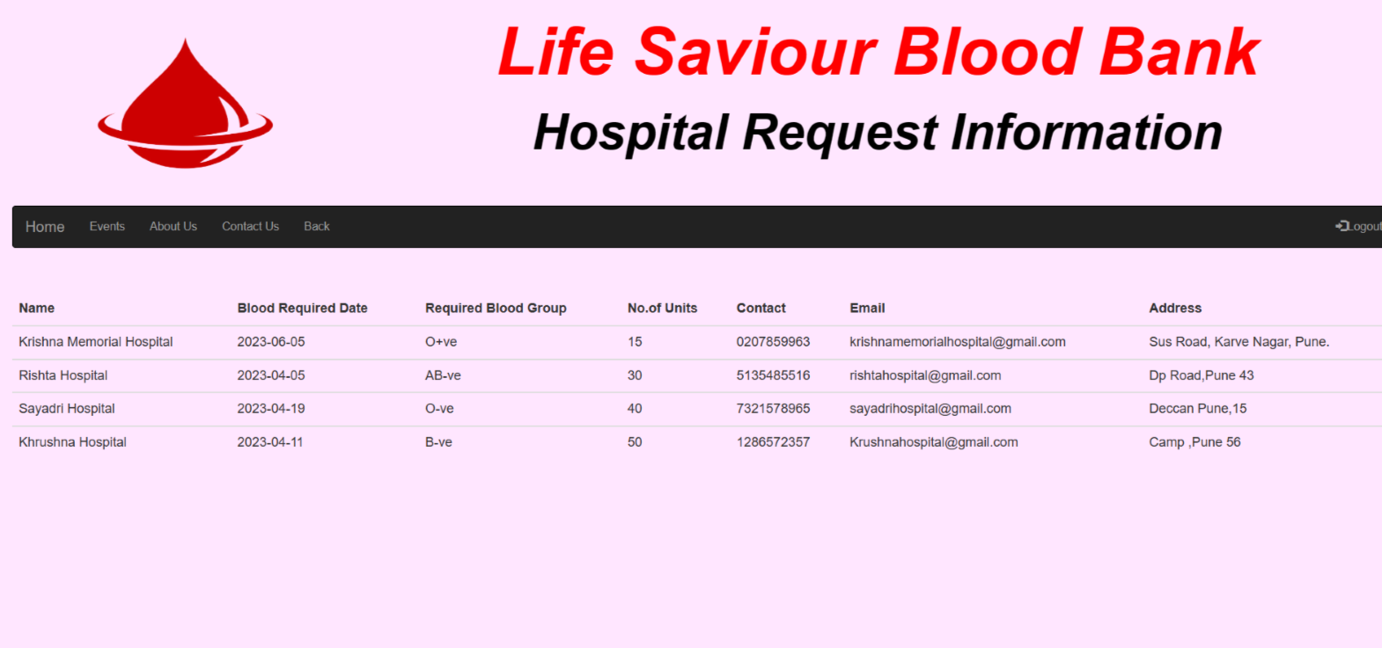
Fig 15: Hospital Request Information Page

Slide 32
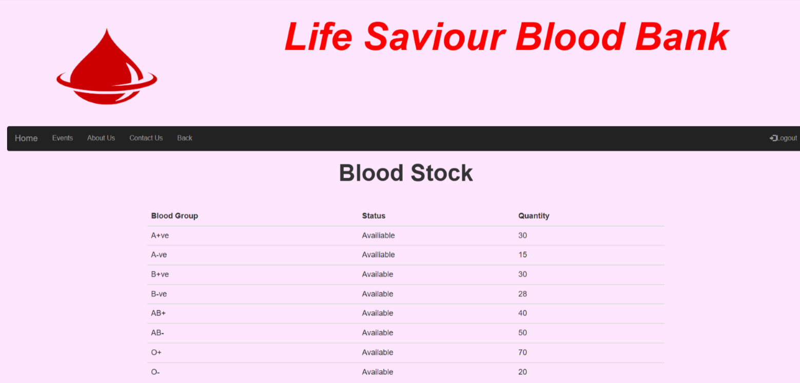
Fig 16: Blood Stock Information Page

Slide 33
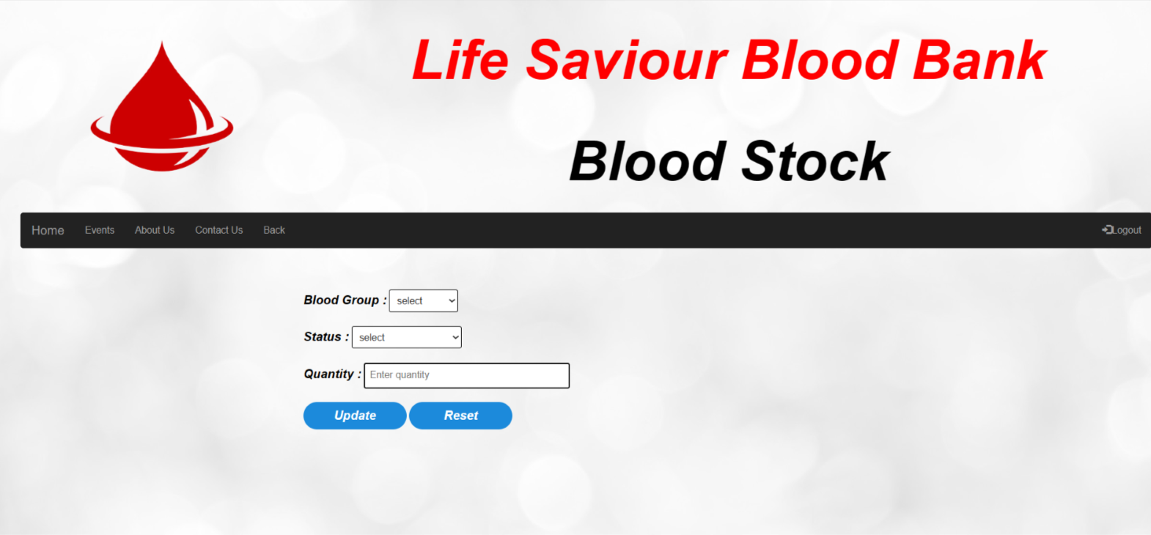
Fig 17: Blood Stock Updating Page

Slide 34
CONCLUSION
Blood Bank Management System is a web-based system which provide convenience, efficiency and security to the system users and hospitals compared to the manual systems. It was found out that manual systems have many disadvantages that disappoint and dissatisfy users. Indeed, online blood bank applications make work easy, and ensure fast retrieval of data when needed. The database is a vital aspect of the system. The database of the hospitals and the blood banks must be checked for consistency on regular basis for smooth working of the system.

Slide 35
References
2018 International Conference on Computer, Control, Electrical, and Electronics Engineering (ICCCEE ) Computerized Central Blood Bank Management.
Proceedings of the Second International Conference on Inventive Systems and Control (ICISC 2018) IEEE Xplore Compliant – Part Number:CFP18J06-ART, ISBN:978-1-5386-0807-4; DVD Part Number:CFP18J06DVD, ISBN:978-1-5386-0806-7.
Framework for Performance Engineering of Workflows .A Blood Bank Case Study Gunnar Brataas , Peter H. Hughes y and Arne Slvberg z. Department of Computer and Information Science Norwegian University of Science and Technology (NTNU)7034 Trondheim, NORWAY.
K. Sazama, Reports of 355 transfusion-associated deaths: 1976 through1985,
Transfusion 30 (7) (1990) 583– 590.
https://www.financialexpress.com/lifestyle/health/no-blood-bank-in-63-districts-of-india-govt data/2185999/(online)
P. Priya and V. Saranya (2014) “The Optimization of Blood Donor Information and Management System by Technopedia” ISO 3297: 2007 3 (1)

